Slide 1

EFFICIENT SOLAR BASED FAST WIRELESS VEHICLE CHARGING STATION
Presentation on
Presented by:
ANUKALP KUMAR (2020041039)
Under Supervision
SUDHANSHU VERMA ( ASSISTANT PROFESSOR)
Department of Electronics and Communication Engineering,
Madan Mohan Malaviya University of Technology, Gorakhpur (UP) , India

Slide 2

Outline of Presentation
Madan Mohan Malaviya University Of Technology, Gorakhpur
Introduction
Block Diagram
Technology and Components Used
Uniqueness
Feasibility of Product
Conclusion and Future Scope
References

Slide 3
Introduction
Madan Mohan Malaviya University Of Technology, Gorakhpur
Briefing Project Idea
We live in a world of technological advancement. New technologies emerge each and every day to make our life simpler. Despite all these, we still rely on the classical and conventional wire system to charge our everyday electronic gadgets.
Our project proposes a novel idea to charge the Electric vehicle wirelessly through the inductive power transfer principle using the transmitting and receiving coil while simultaneously decreasing the battery size and improving the convenience and without the requirement of the cable.
The electric vehicle can be charged both by the static wireless power transmission (SWPT) and dynamic wireless power transmission (DWPT) method.

Slide 4
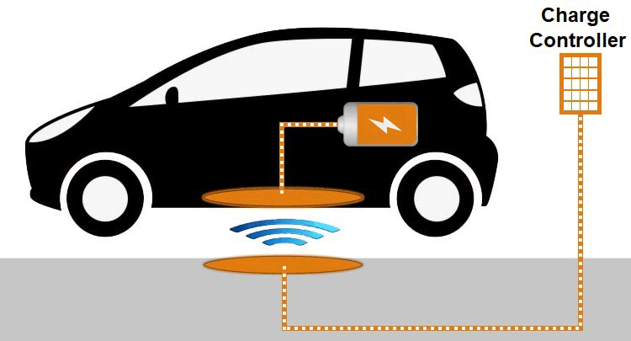
Objective
Madan Mohan Malaviya University Of Technology, Gorakhpur
Proposal for wireless charging of Electric Vehicles (EVs) via inductive power transfer principle using transmitting and receiving coils.
Aim: Overcome limitations of current EV charging systems—unsatisfactory energy density, limited battery lifetime, and high costs.
Strategy: Utilize both static wireless power transmission (SWPT) and dynamic wireless power transmission (DWPT) methods.
Fig1. Wireless EV Charging

Slide 5
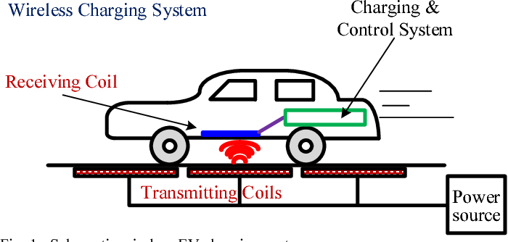
Literature review and Previous Existing Model
Madan Mohan Malaviya University Of Technology, Gorakhpur
Research indicates a growing interest in wireless charging stations powered by solar energy due to their potential for sustainable and convenient electric vehicle (EV) charging.
Studies highlight the integration of solar panels with wireless charging technology to harness renewable energy for EVs, reducing dependence on the grid and fossil fuels.
Current models of solar-based wireless charging stations typically consist of solar panels installed on canopies or overhead structures, capturing sunlight to generate electricity.
Fig2. Wireless Charging System

Slide 6
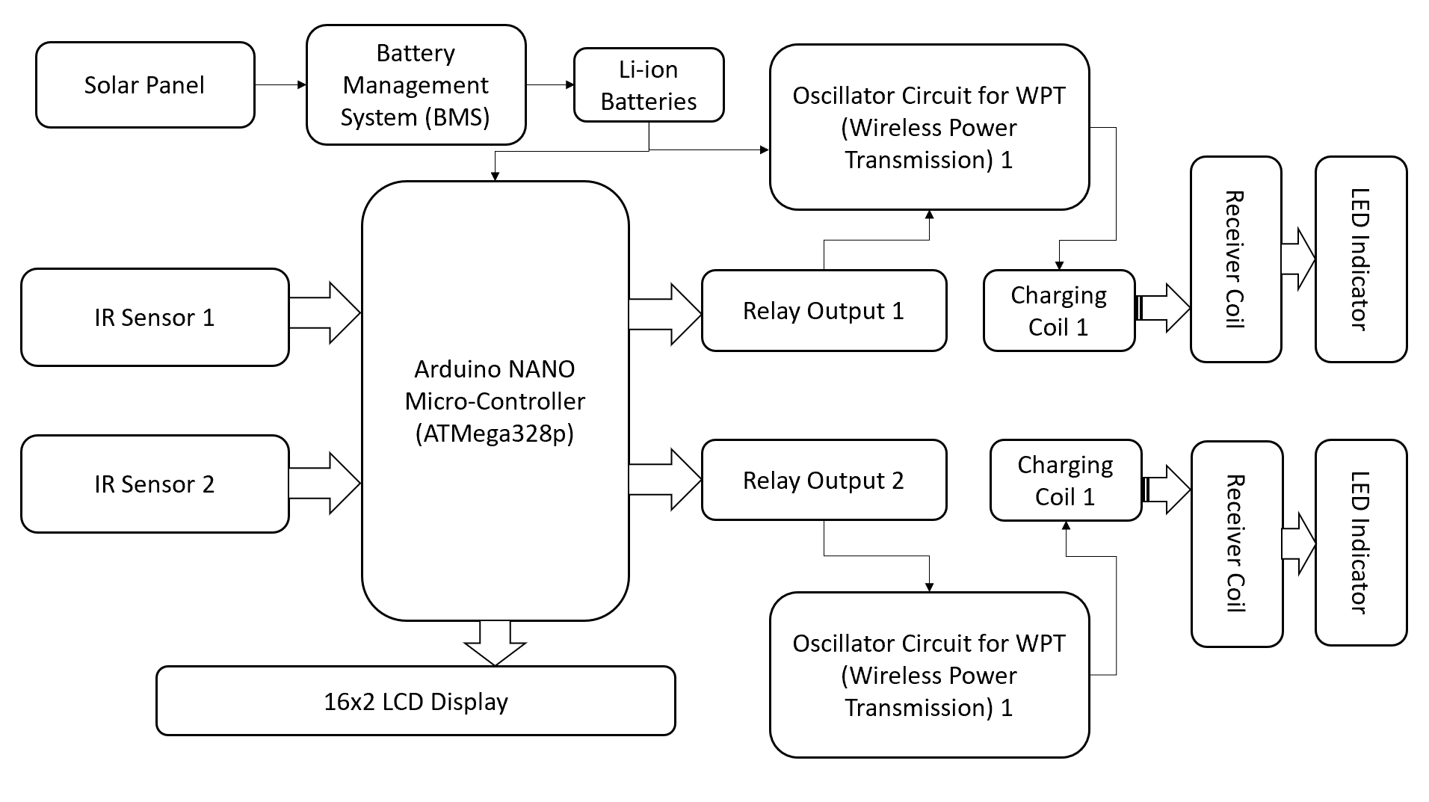
Block Diagram
Madan Mohan Malaviya University Of Technology, Gorakhpur
Fig3. Block Diagram

Slide 7
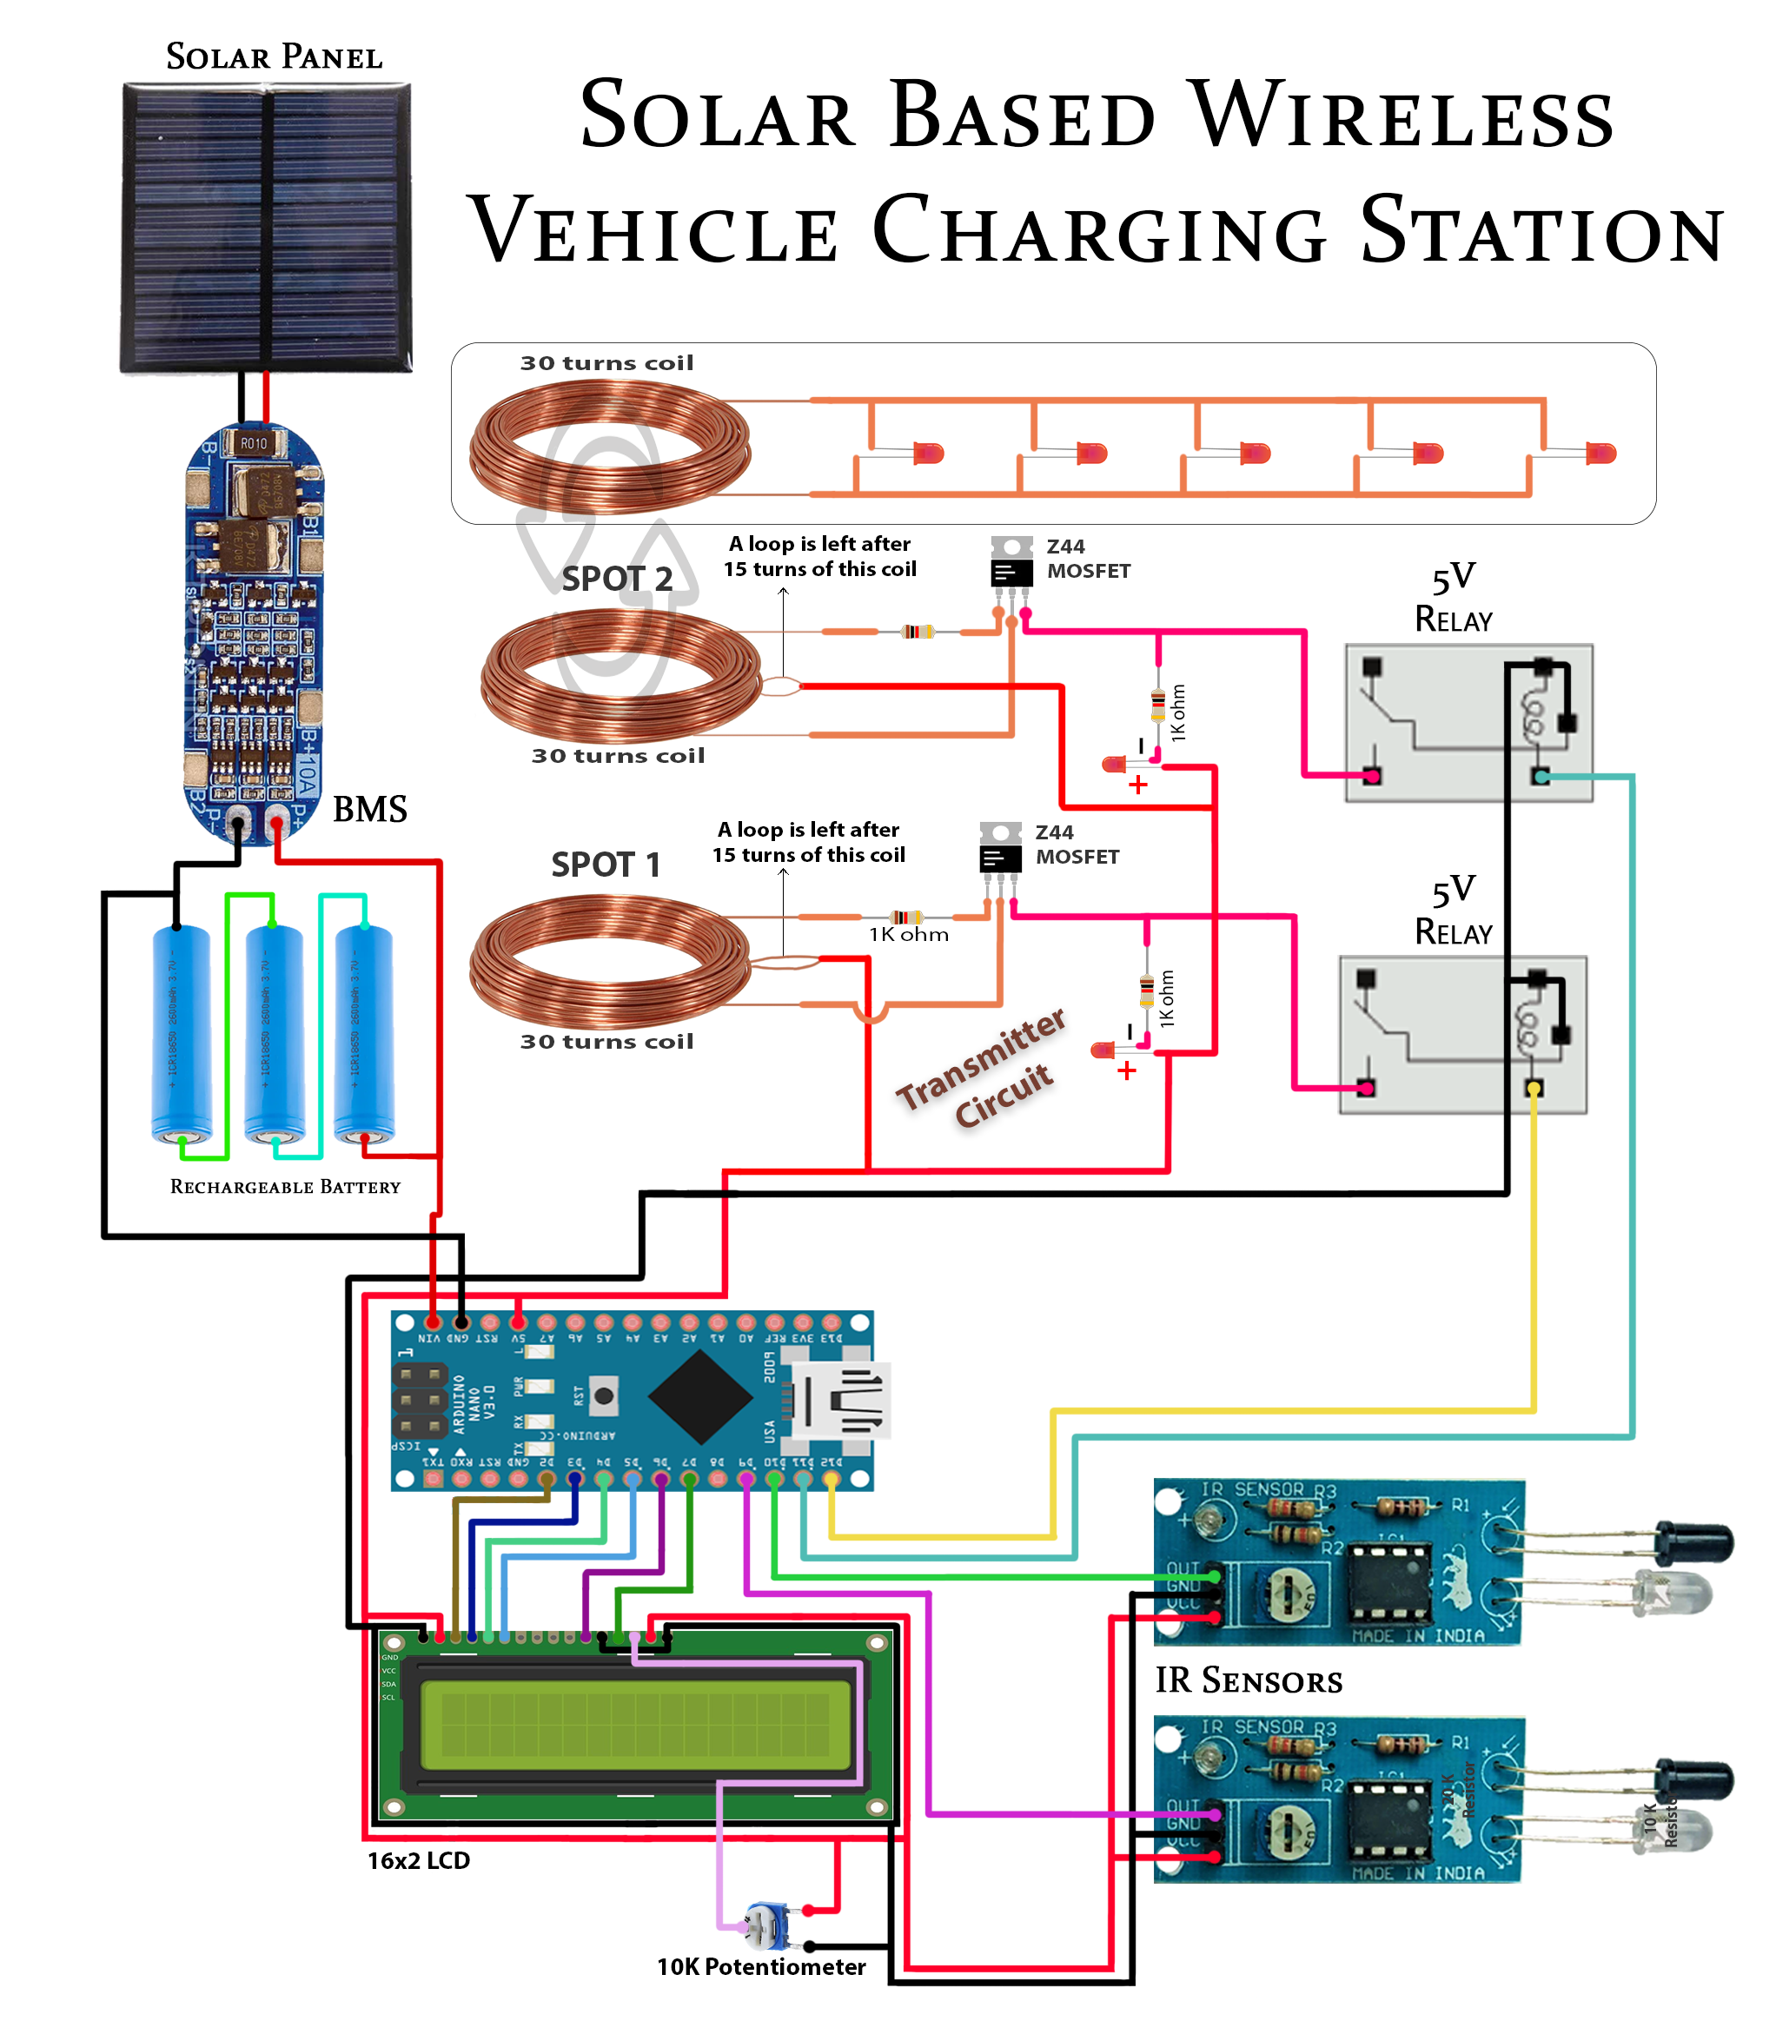
Madan Mohan Malaviya University Of Technology, Gorakhpur
Fig4. Circuit Description

Slide 8
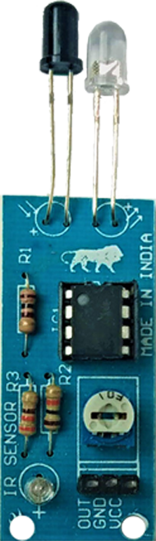
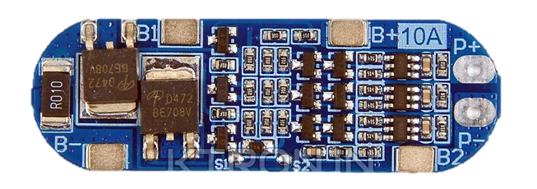
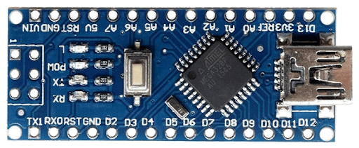
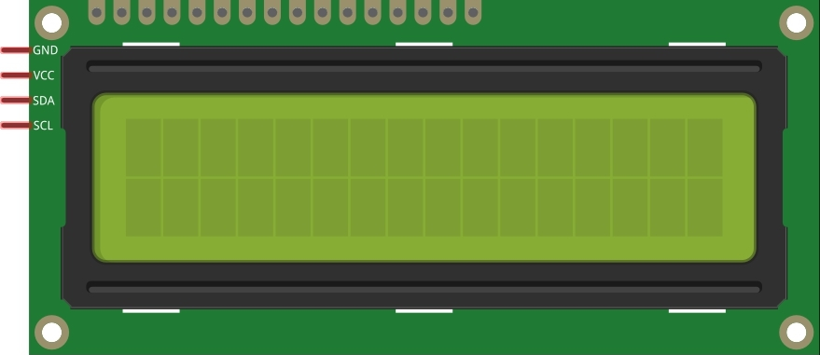
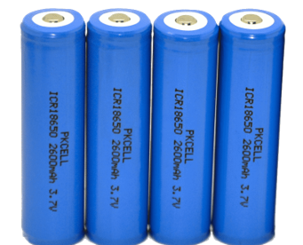

Technology and Components Used
Madan Mohan Malaviya University Of Technology, Gorakhpur
Hardware Components:
Fig7. BMS
Fig5. Arduino NANO
Fig6. IR Sensors
Fig8. LCD
Fig10. MOSFET (Transistor)
Fig9. Rechargeable Cells

Slide 9
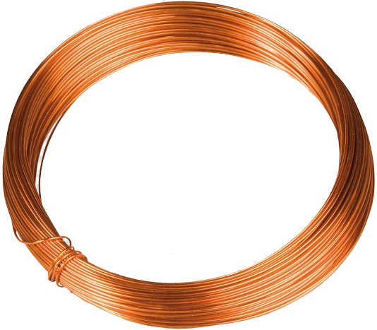
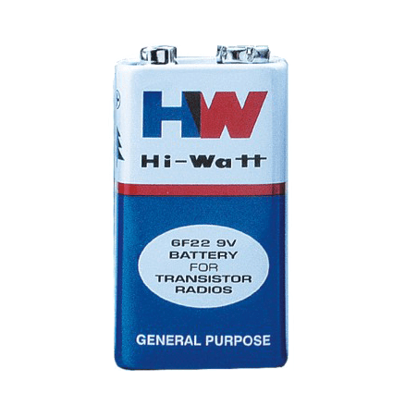

Madan Mohan Malaviya University Of Technology, Gorakhpur
Copper Wire (25 Gauge) – To make Coils for wireless power transmission
Fig12. Batteries
Fig13. Battery Caps
Fig11.
Software Component:
1. Arduino IDE
2. C++ Code for Arduino

Slide 10

Arduino IDE:
Madan Mohan Malaviya University Of Technology, Gorakhpur
The Arduino Integrated Development Environment (IDE) is the main text editing program used for Arduino programming. It is where you’ll be typing up your code before uploading it to the board you want to program.
Fig14.

Slide 11
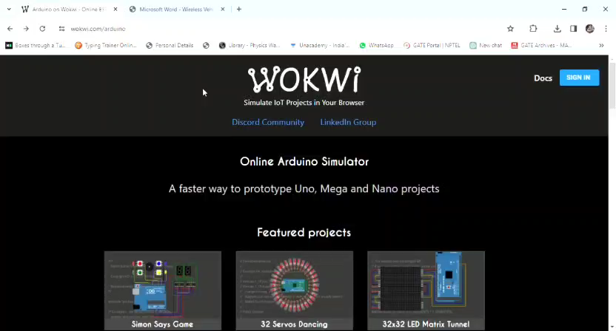
C++ Code For Arduino
Madan Mohan Malaviya University Of Technology, Gorakhpur

Slide 12
Uniqueness
Madan Mohan Malaviya University Of Technology, Gorakhpur
Size :
Compared to existing solutions, emphasize a more compact and streamlined design that optimizes space and infrastructure.
Performance :
Showcase superior energy conversion rates or charging speeds compared to traditional solar-based wireless charging stations. Highlight advancements in power delivery efficiency, ensuring faster and more effective charging.
Cost-effectiveness:
Emphasize a competitive advantage in terms of the overall cost of installation, operation, and maintenance compared to existing market solutions.
Innovation of Project:
Wireless charging of vehicles without any wires. No need to stop for charging, vehicle charges while moving Solar power for keeping the charging system going. No external power supply needed Coils integrated in road to avoid wear and tear.

Slide 13
Feasibility of Product
Madan Mohan Malaviya University Of Technology, Gorakhpur
Impact on the Industry
Sustainability and Environment
Convenience and User Experience
Scalability and Infrastructure Development
Possibility to Convert Idea into a Product
Technological Viability
Market Demand and Feasibility
Manufacturability and Cost Considerations

Slide 14
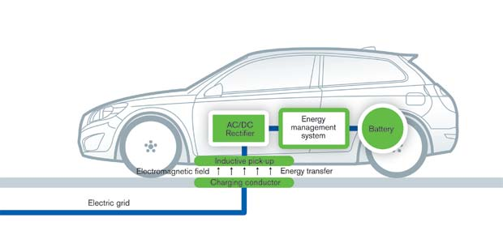
Conclusion and Future Scope
Madan Mohan Malaviya University Of Technology, Gorakhpur
In this system, we are presenting the Wireless Power Transmission.
As the electric vehicle in the market is increasing. We can use the wireless charging system to charge our vehicles.
This system shows the efficiency and implementation of the charging station in future technology.
Overall this compares various smart parking, charging and combined charging-parking system, which can help to solve various issues related with it.
Fig15.

Slide 15
Layout
Madan Mohan Malaviya University Of Technology, Gorakhpur
Member 1:
Oversee the entire project, ensuring that all tasks are completed on time and within budget.
Design and develop the electrical systems for the wireless charging station.
Ensures the seamless integration of the Arduino Nano with the wireless charging station components.
Member 2:
Integrate solar energy components (such as solar panels) with the charging system.
Ensure that the system meets safety standards and regulatory requirements.
Tests the code for the Arduino Nano.
Member 3:
Perform simulations and tests to validate the design and performance.
Develop strategies for energy storage and management to ensure continuous operation.
Writes the code for the Arduino Nano to control and monitor the wireless charging station.
Member 4: NULL

Slide 16
Madan Mohan Malaviya University Of Technology, Gorakhpur
Schedule of Activities
Table 1: Schedule of Activities of 7th Semester
S. No. | Activities/Work Done | Duration (/Days/Month) | Remarks
1. | Define project scope and objectives. Assign roles and responsibilities. | 1 Week | Completed
2. | Research wireless charging technologies and components. Gather requirements for electrical system design. | 1 Week | Completed
3. | Research relevant Arduino libraries and coding practices. Gather requirements for software and hardware integration. | 1 Week | Completed
4. | Design the electrical layout and circuit diagrams. | 1 Week | Completed

Slide 17
Madan Mohan Malaviya University Of Technology, Gorakhpur
Table 2: Schedule of Activities of 8th Semester
S. No. | Activities | Duration
1. | Start coding basic functions for Arduino Nano. Develop initial prototype for testing basic functionality. | 2 Week
2. | Conduct final integration of all system components. | 1 week
3. | Perform comprehensive testing to ensure system functionality and reliability. | 3 Days
4. | Compile and review all documentation and test results. | 2 Days
5. | Preparation and submission of project report. | 5 Days

Slide 18
References
Madan Mohan Malaviya University Of Technology, Gorakhpur
[1] Wang, Y., Huang, Y., & Zhang, C. (2019). "Design and Implementation of Wireless Charging System for Electric Vehicles." IEEE Access, 7, 134597-134607.
[2] Lim, T., Kim, S., & Choi, J. (2020). "Performance Analysis of Wireless Charging Systems for Electric Vehicles." Energies, 13(6), 1475.
[3] H. Wang, W. Shi, Q. Huang, "An Efficient Electric Vehicle Charging System with Wireless Power Transfer," IEEE Transactions on Power Electronics, vol. 33, no. 5, pp. 4139-4151, May 2018.
[4] Y. Zhang, H. Zhang, Z. Wang, "Integration of Solar Energy and Wireless Charging for Electric Vehicles: A Review," IEEE Transactions on Sustainable Energy, vol. 10, no. 2, pp. 866-876, Apr. 2019.

Slide 19
THANK YOU

